Slide 1
Unsupervised Hyperspectral Image Segmentation of Indian Pine
Team ALPHA

Slide 2
Understanding the data
Hyperspectral Imaging performed using remote sensing devices. This works by analyzing electromagnetic radiation transmitted through a large spectrum of bands, reflected from, or absorbed by a local observed medium; i.e. Land mapping.
Challenge: Understanding the data set.

Slide 3
Goal
The purpose of this experiment was to properly classify the labeled data from the ground truth into recognizable clusters.

Slide 4
DESIGN AND Implementation
Create an algorithm that iterates through each spectral band to understand the dataset entirely.
PCA: performed to maximize variance and reduce the amount of features used in classification.
K-Means: Used to cluster the data after PCA feature reduction.
Neighborhood Bias: Smooths decision area to make image less pixilated
i.e.: Probabilistic K-NN

Slide 5
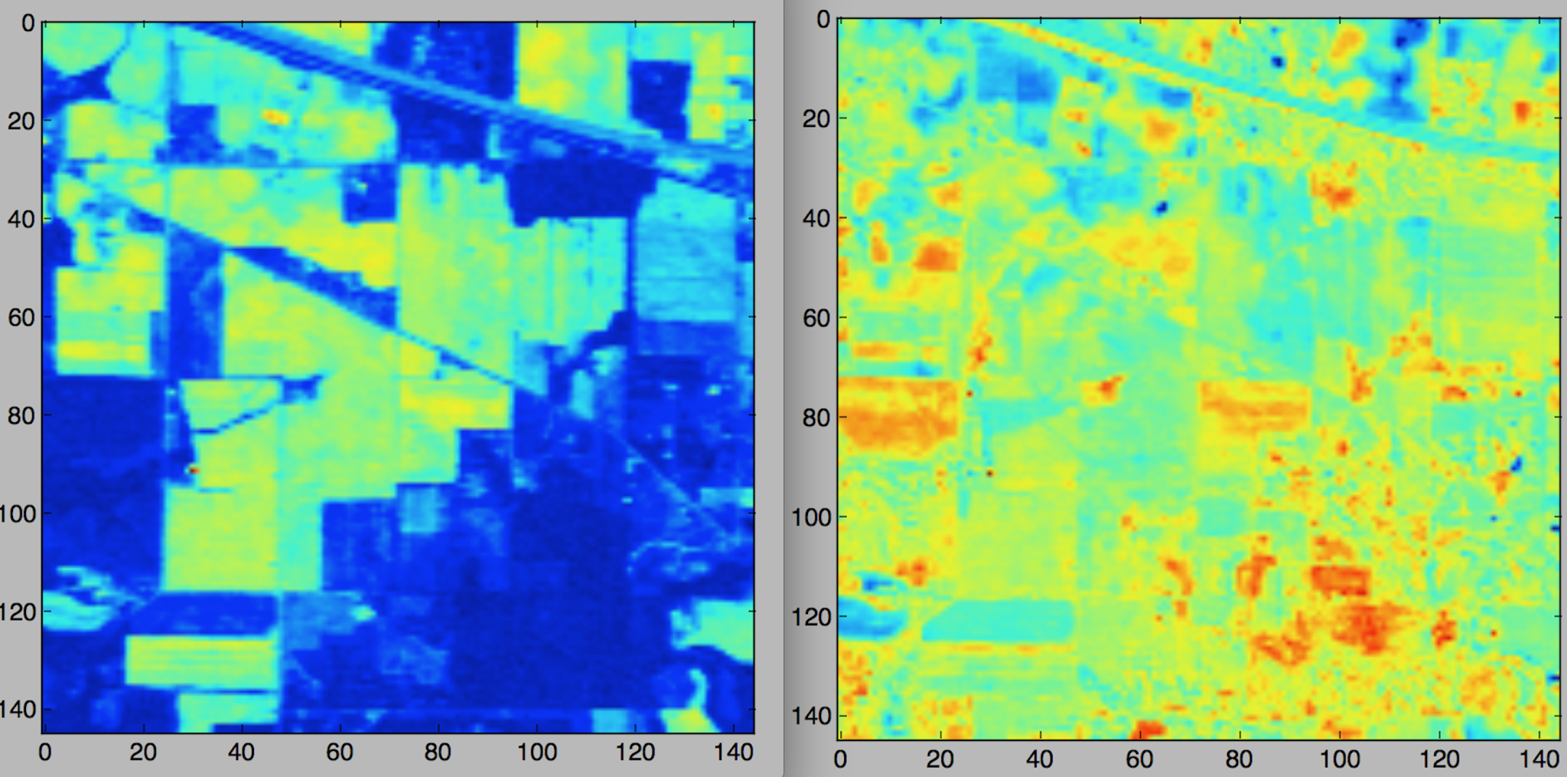
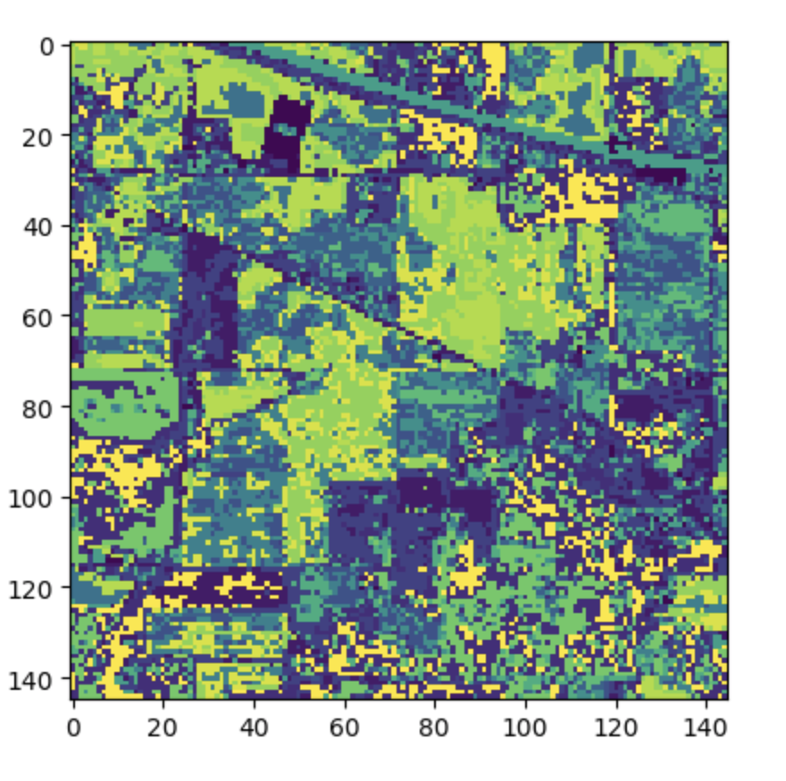
Results: PREPROCESSING AND PCA
Before PCA: The spectral bands to the left.
After PCA: The spectral bands to the right.
Advantages: Able to implement K-Means to generate image.

Slide 6
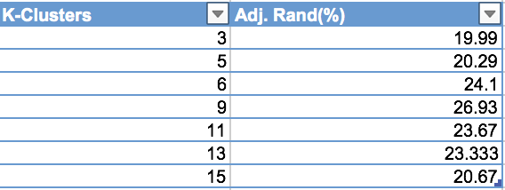
RESULTS: K-MEANS CLUSTERING
Observation:
Though the ground truth cluster number is 16, the optimal number of experimental clusters was much smaller.

Slide 7
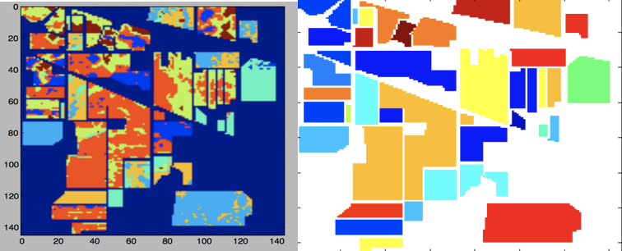
RESULTS: BEFORE NEIGHBORHOOD BIASING

Slide 8
RESULTS: AFTER NEIGHBORHOOD BIASING
Neighborhood biasing provides more higher accuracy with larger clusters by smoothing out the decision space associated with each data point according to its surroundings.
Clustering after biasing applied.

Slide 9
Questions?
Thank you

